Slide 1
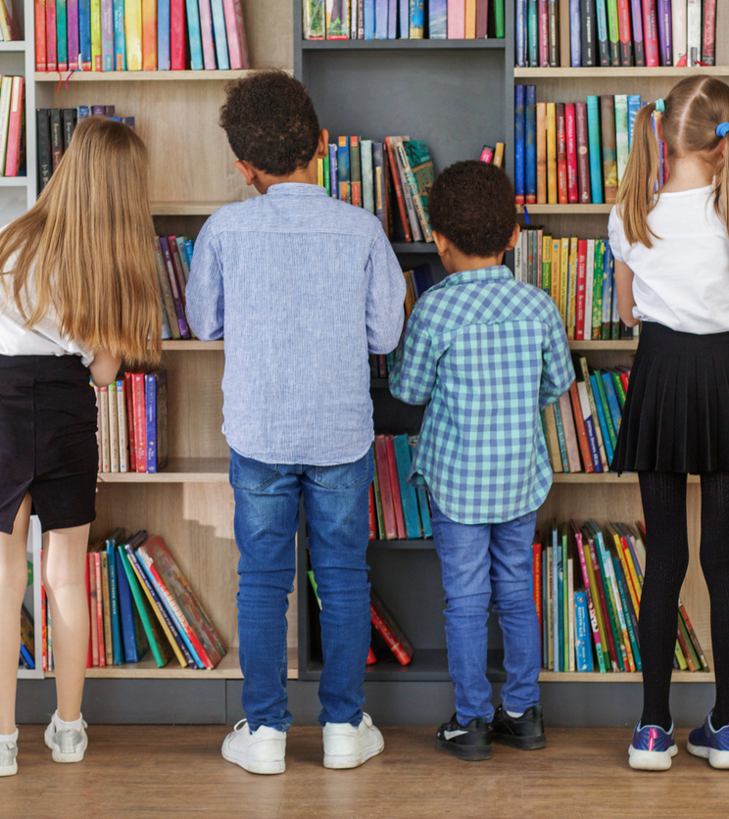
The social value
of public libraries
The case of the Barcelona Province Library Network

Slide 2

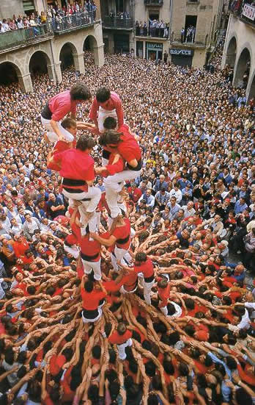
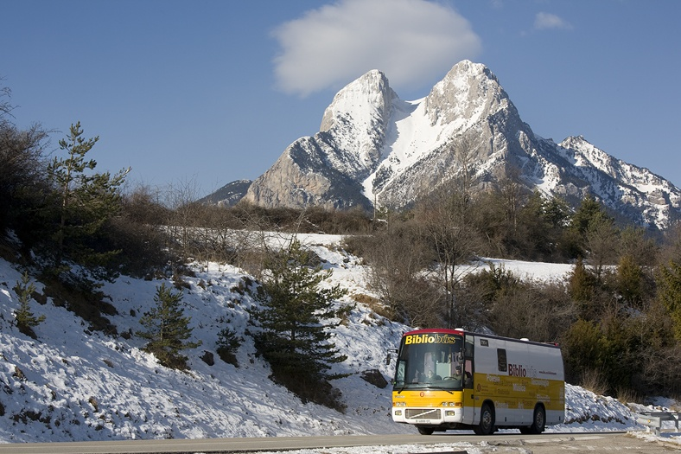
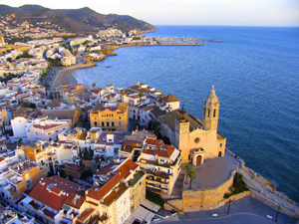
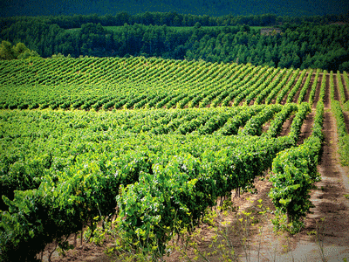
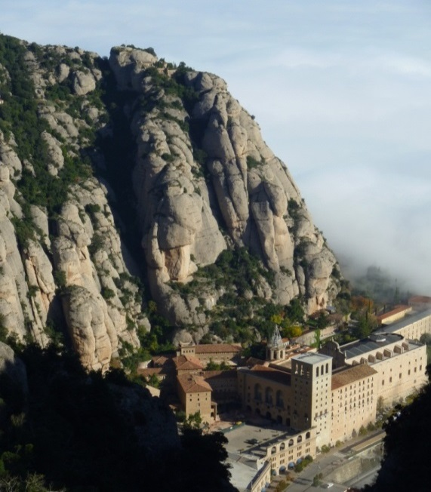
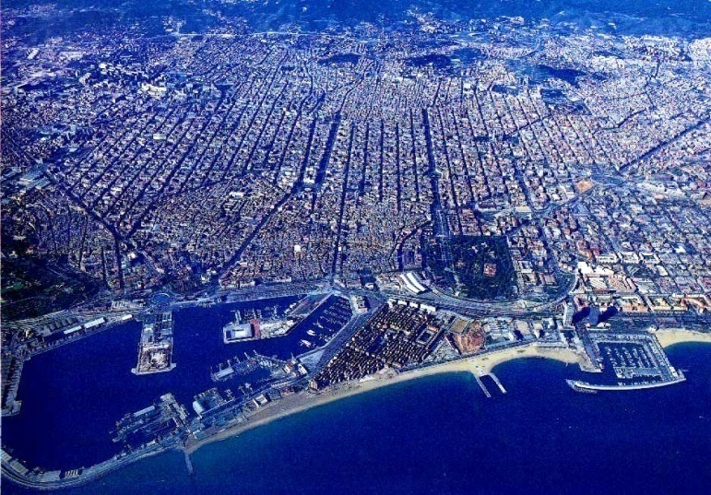
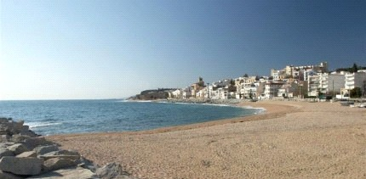
The province of Barcelona
Territory, population & government
Notes:
2

Slide 3
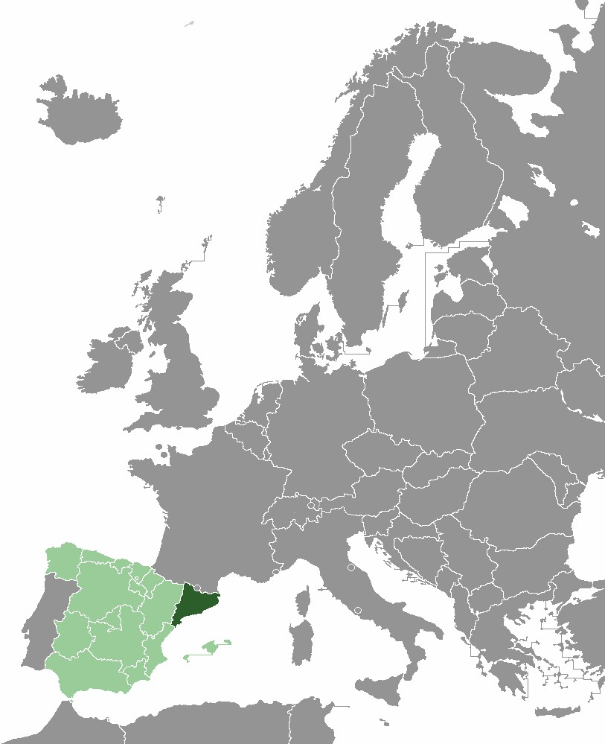
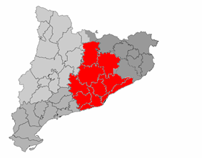
The Barcelona province
Area Population
(km²) (2023)
Spain 505,992 49 M
Catalonia 32,108 8.0 M
BCN province 7,726 5.8 M
Barcelona
province
Notes:
The Autonomous Community of Catalonia has a population of 7.7 million inhabitants of which 5.7 million live in the province of Barcelona, ​​i.e. more than 74% of the population distributed in 311 municipalities.

Slide 4
The Barcelona Province Library Network
The Barcelona Provincial Council provides technical and economic support to local governments for creating and managing local public libraries and develop quality services.
Public libraries are a mandatory service for municipalities +5,000 inhabitants
Our priorities:
Equal access ensuring territorial balance and lifelong opportunities.
Economies of scale, providing networking and shared management among libraries.
and maintaining high quality of library services.
Common management model + accommodation of community uniqueness on every library.
236 Libraries +12 Mobile libraries
286 municipalities with library services
150 municipalities with libraries (236 libraries)
137 municipalities with mobile libraries (12 Mobile libraries)
5.7 million inhabitants
98,7% of the population with
library service at their municipality
Notes:
4
The Municipal Library Network
The Municipal Library Network, is a large network of public libraries, with a long history spanning more than a century and a shared operational model.
currently has 235 libraries and 13 mobile libraries, serving a population of more than 5.7 million inhabitants. People living in 253 municipalities in the Barcelona province. This translates into 98% of the population in the province, of which half (2,726.493 people) own a library card that allows them to enjoy the services offered by public libraries.
We lead the Network of Municipal Libraries of the Province with the aim of:
Equal access ensuring territorial balance and lifelong opportunities.
Economies of scale, providing networking and shared management among libraries.
Common management model + every community is unique.

Slide 5
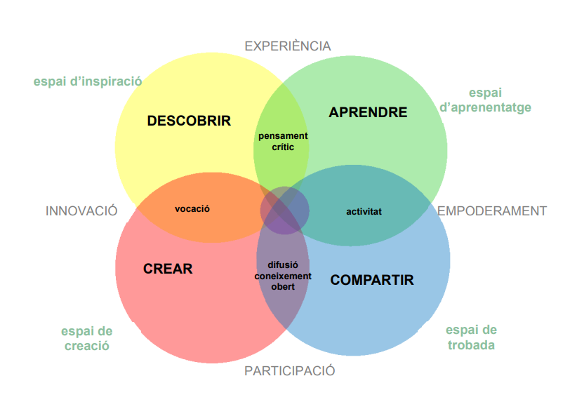

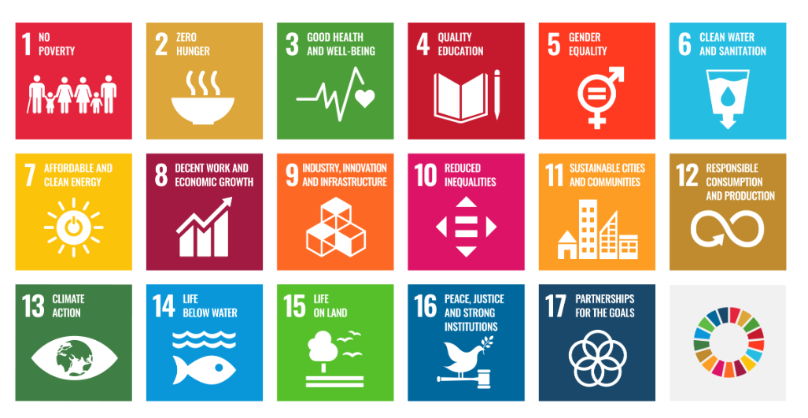
Current context
Sustainable Development Goals
Common model + unique projects in each territory
Cultural rights

Slide 6
Trends and challenges of public libraries (based on IFLA trend report)
Accessibility
Community health and mental health
Immediacy in the provision of services
Citizen participation
Digital divide
Lifelong learning
Library as a workspace
Population aging
Sustainability
Media and information literacy
Unwanted loneliness
Reading comprehension

Slide 7
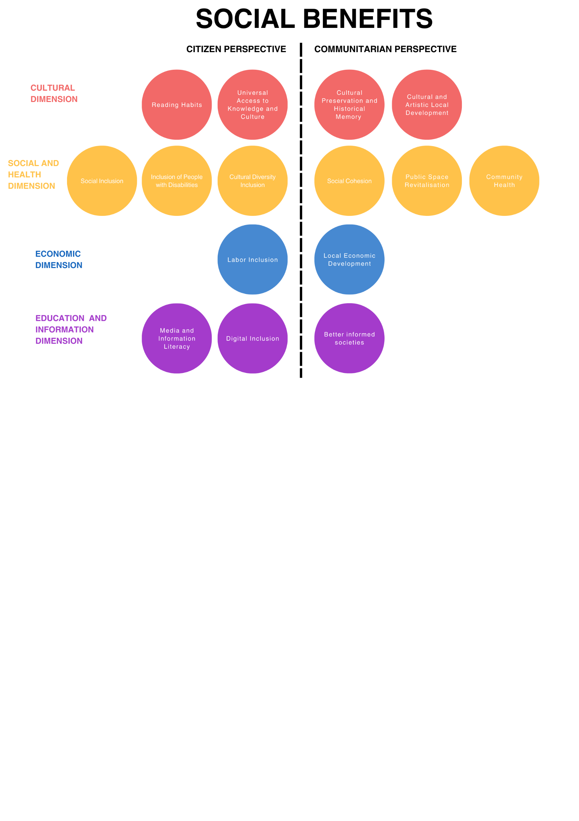
Social benefits of public libraries
(the benefits defined in 2015)
Link to the document published in July 2015 (abridged version):
https://www.diba.cat/documents/16060163/22275360/valor_social_bibliotequesXBM_angles.pdf/39255278-b39e-4f98-893e-76869b63a4b4

Slide 8
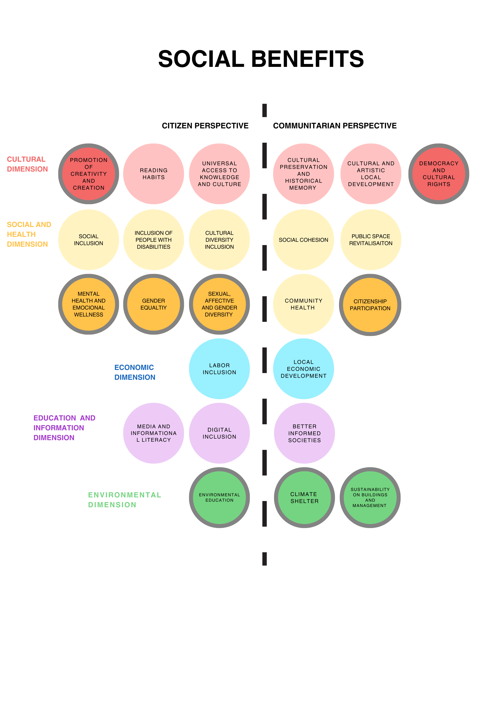
Social benefits of public libraries
(with the new benefits defined)
New social benefits defined

