Slide 1

Notes:
https://www.youtube.com/shorts/ztjyGFBBTUE

Slide 2
In the next minutes....
https://www.youtube.com/shorts/ztjyGFBBTUE
The Barcelona Provincial Council
CULTURE 311+
Context Rights Cultural Plan
Axes and areas
Examples of projects

Slide 3
The Barcelona Province Library Network
The Barcelona Provincial Council provides technical and economic support to local governments for creating and managing local public libraries and develop quality services.
Public libraries are a mandatory service for municipalities +5,000 inhabitants
Our priorities:
Equal access ensuring territorial balance and lifelong opportunities.
Economies of scale, providing networking and shared management among libraries.
and maintaining high quality of library services.
Common management model + accommodation of community uniqueness on every library.
236 Libraries +12 Mobile libraries
286 municipalities with library services
150 municipalities with libraries (236 libraries)
137 municipalities with mobile libraries (12 Mobile libraries)
5.7 million inhabitants
98,7% of the population with
library service at their municipality
Notes:
3
The Municipal Library Network
The Municipal Library Network, is a large network of public libraries, with a long history spanning more than a century and a shared operational model.
currently has 235 libraries and 13 mobile libraries, serving a population of more than 5.7 million inhabitants. People living in 253 municipalities in the Barcelona province. This translates into 98% of the population in the province, of which half (2,726.493 people) own a library card that allows them to enjoy the services offered by public libraries.
We lead the Network of Municipal Libraries of the Province with the aim of:
Equal access ensuring territorial balance and lifelong opportunities.
Economies of scale, providing networking and shared management among libraries.
Common management model + every community is unique.

Slide 4
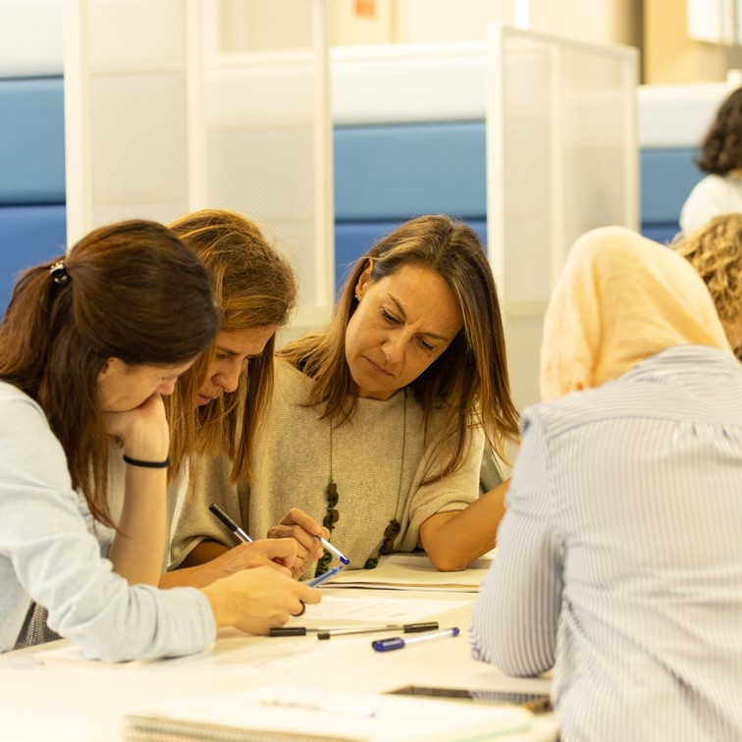
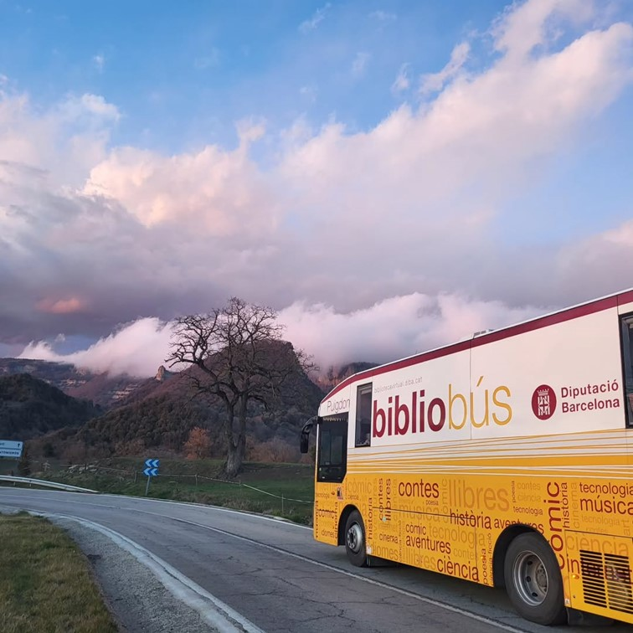
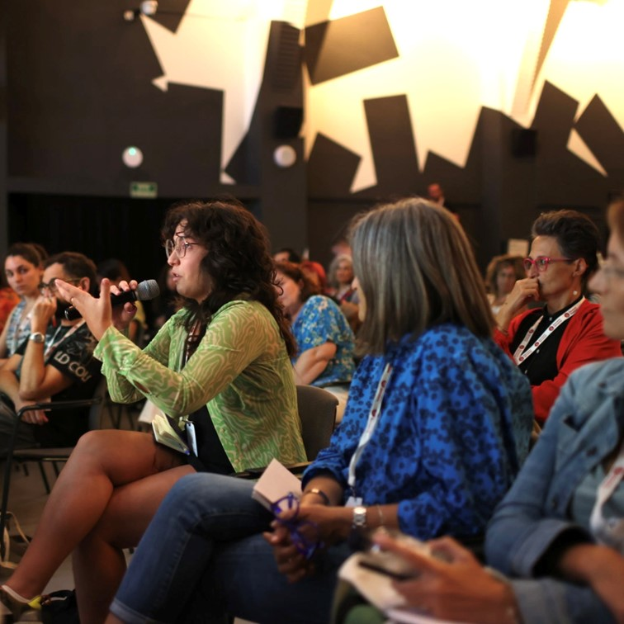
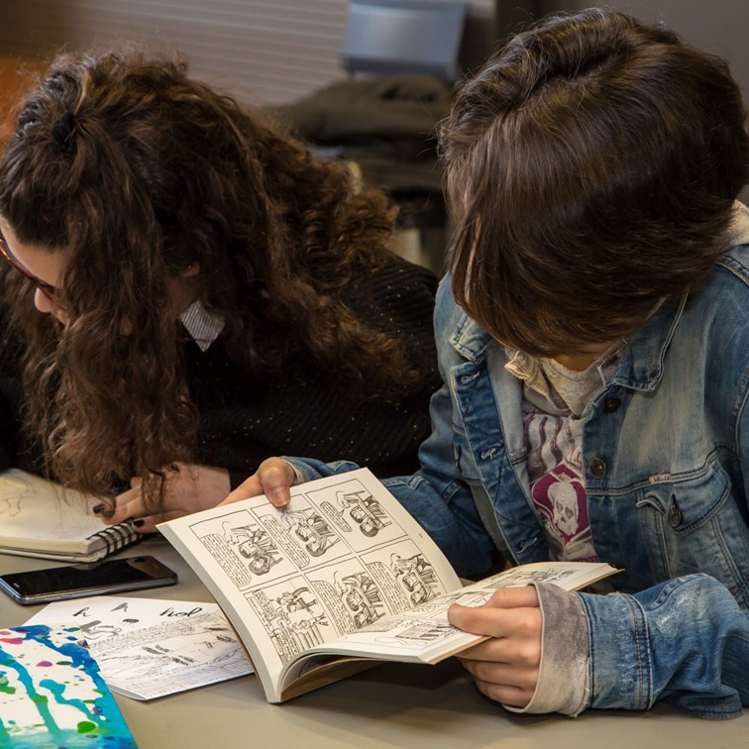
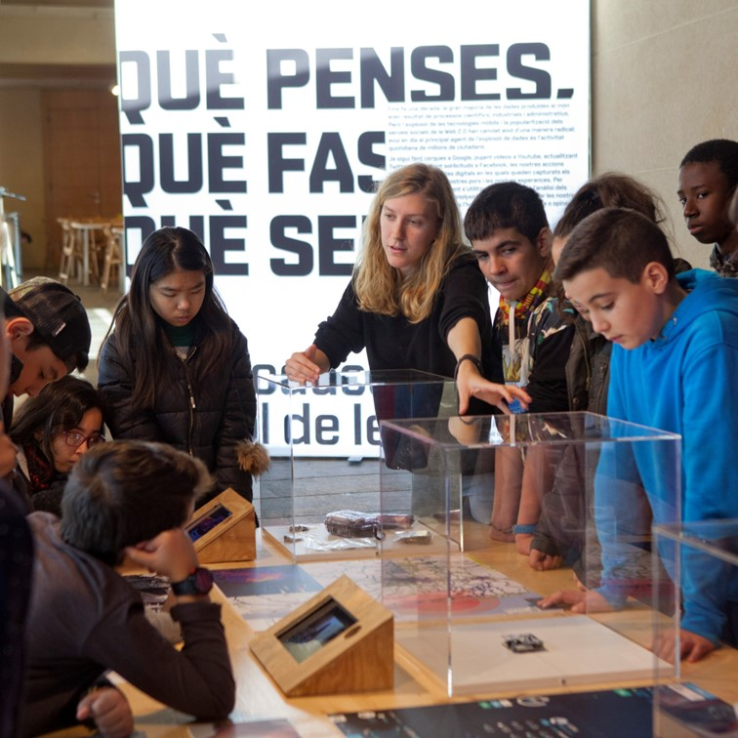
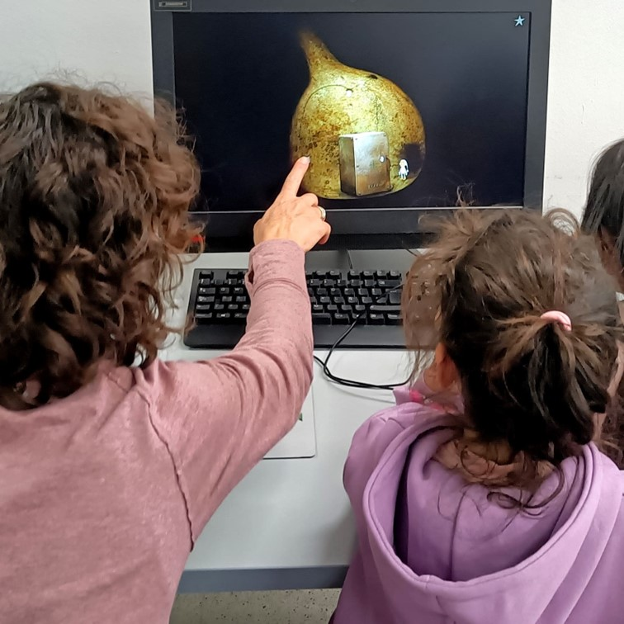
What is Cultura 311 +
Promote policies in favor of cultural rights with municipalities.
- Transversalize strategies.
- Integrate all the cultural action promoted by the Barcelona Provincial Council.
- Facilitate collaboration between institutions and communities.
- Aim to expand the scope and impact of cultural rights.
Notes:
A strategic plan that becomes a comprehensive commitment to promote policies in favor of cultural rights with the municipalities. With the aim of mainstreaming strategies and integrating all of the cultural action promoted by the Barcelona Provincial Council and facilitating collaboration between public institutions, private entities and communities with the aim of expanding the scope and impact of cultural rights. More information in the English version of the document:
http://www.diba.cat/documents/d/drets-culturals/cultura311-_pla_drets_culturals_diba_eng_web-1-

Slide 5
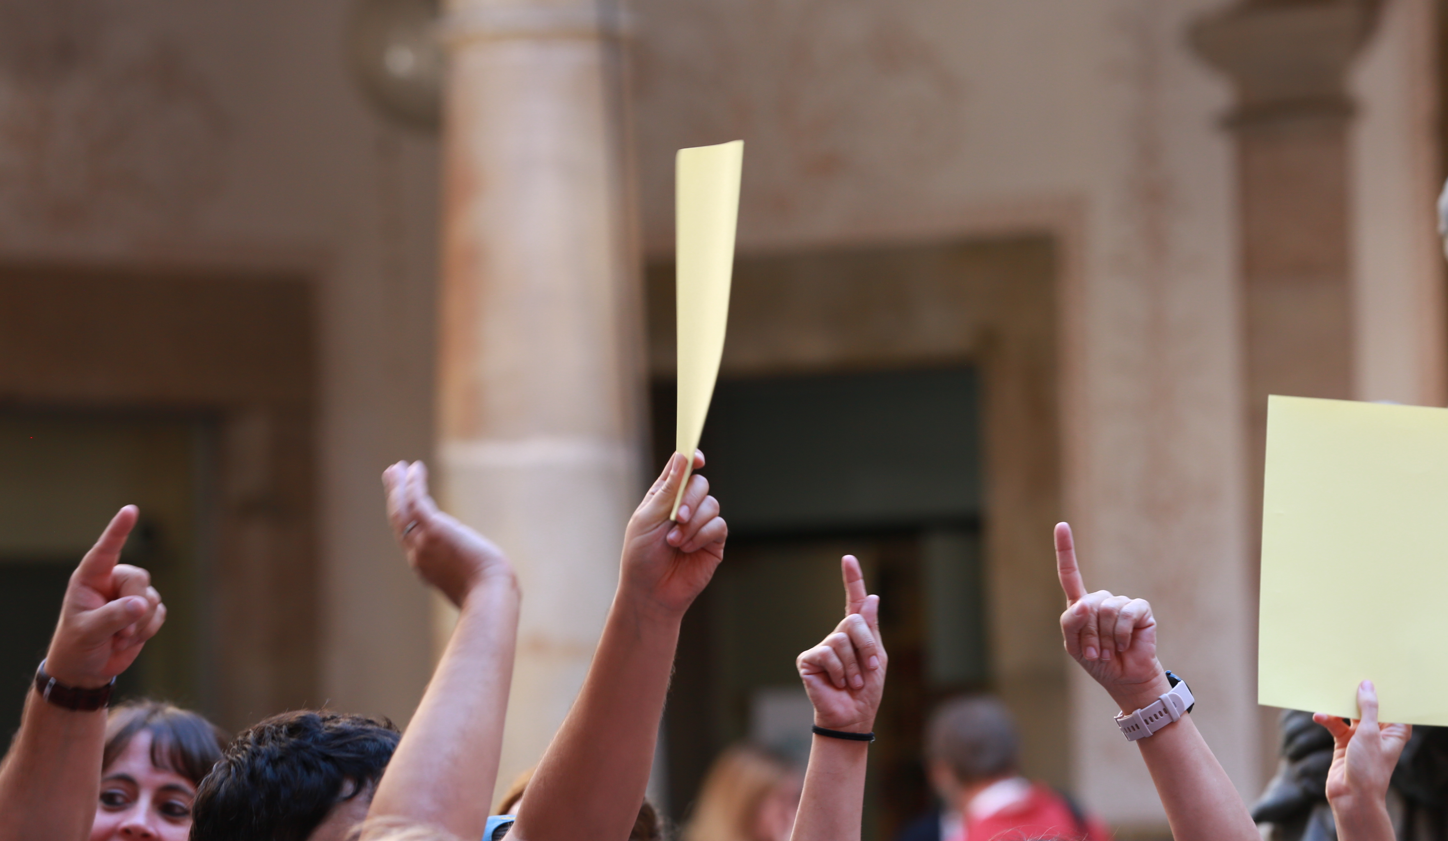
CONTEXT: for a cultural citizenship
If during the 20th century the right to Health and education were key to equality and social democratization, in the 21st century cultural policies are also central to reducing inequalities and expandint the rights and opportunities of citizens.
Notes:
For a cultural citizenship If during the 20th century the right to health and education were key to equality and social democratization, in the 21st century cultural policies are also central to reducing inequalities and expanding the rights and opportunities of citizenship.
More information in the English version of the document:
http://www.diba.cat/documents/d/drets-culturals/cultura311-_pla_drets_culturals_diba_eng_web-1-

Slide 6
CULTURA 311+
Eixos
That’s access
Area 1
Cultural and artístic languages
This participation
Area 6
Mediation and education
Area 2
Reading action
Area 3
Cultural heritage
Area 4
Infrasructure and equipment
Area 5
Institucional and citizen cultural fabric
Area 7
Comunity culture
Area 8
Artistic and literary creation
Innovation and knowledge axis
Area 12
Strategic analysis and planning
Area 11
Democratization of information and open data
Area 10
Learning communities
Area 9
Institutional innovation
Notes:
More information in the English version of the document:
http://www.diba.cat/documents/d/drets-culturals/cultura311-_pla_drets_culturals_diba_eng_web-1-

Slide 7
That’s access
Featured Actions
Juvenile justice libraries and educational centers Project (lifetime coverage)
Notes:
The project “Libraries and educational centers for juvenile justice” works on culture and reading as a tool for integration and social reintegration through a collaborative program with the educational centers for juvenile justice of the Generalitat de Catalunya. The objective is that young people deprived of their liberty can have access to all library services like the rest of society and that new opportunities are generated for them based on new learning. Motivation: To guarantee access, territorial coverage is essential but not sufficient: it must be complemented with vital reading coverage, accompanying people with reading in all situations of life, from early childhood to adulthood, and also in those situations in which, due to various circumstances, it is more complicated to access it.

Slide 8
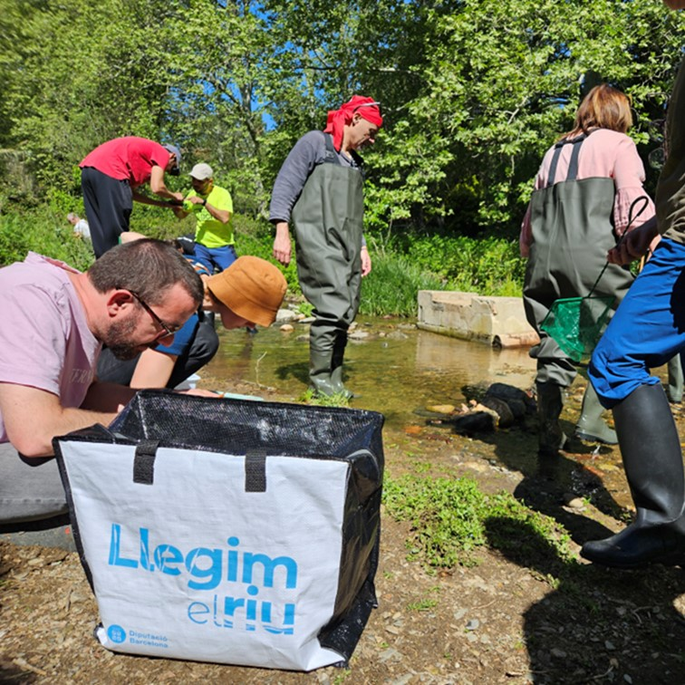
This participation
Featured Actions
Citizen science:
Wea read the river
Notes:
Explanation: Citizen science project initiated in river basins The objective is to promote knowledge of these spaces and the collaboration of citizens in their protection. 28 libraries of the XBM are currently participating. The initiative promotes social innovation points created in libraries through communities of users who work on the hydrological and ecological state of a river. Legim el riu focuses on the knowledge of the water quality of the river and its tributaries in its area of ​​influence, which should allow the generation of new data, research and interpretation of information. Motivation: By developing citizen science projects in libraries, we involve citizens and promote creativity and community collaboration to resolve collective challenges, especially in the areas of sustainability and the environment.

Slide 9
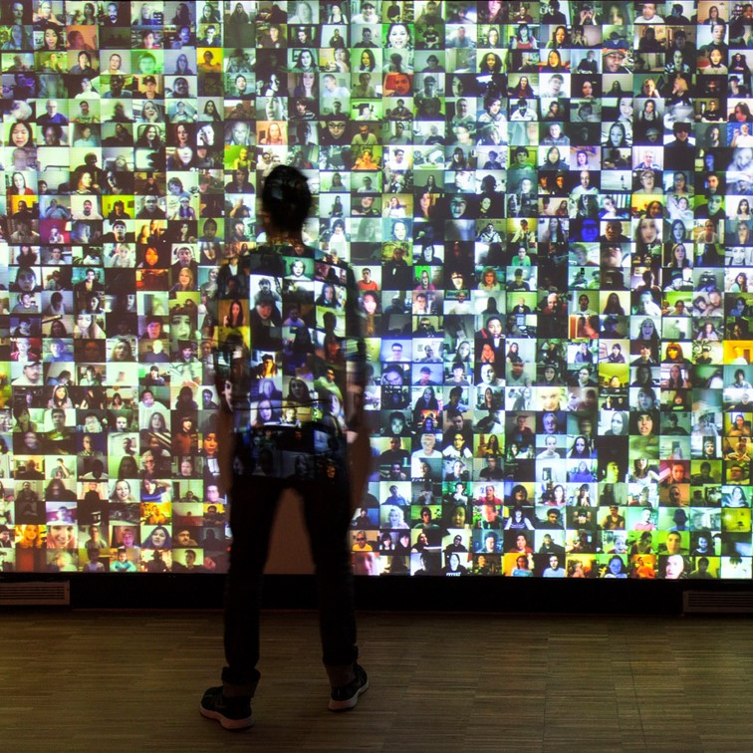
This participation
Featured actions
Support for community creation, experimentation and social innovation projects.
Notes:
Explanation: For 2025-2026, a call for financial aid to support community creation in the libraries of the XBM is planned. The purpose is to resolve local social challenges through community creation, forging alliances with various agents of the local ecosystem and accompanying them in the process of transformation of the XBM Model of public library. The participation of around thirty libraries is planned through project subsidies. Motivation: The aim is to strengthen social cohesion by promoting access, learning and the creation of knowledge through experimentation, creativity and innovation in collaborative environments open to citizens.

Slide 10
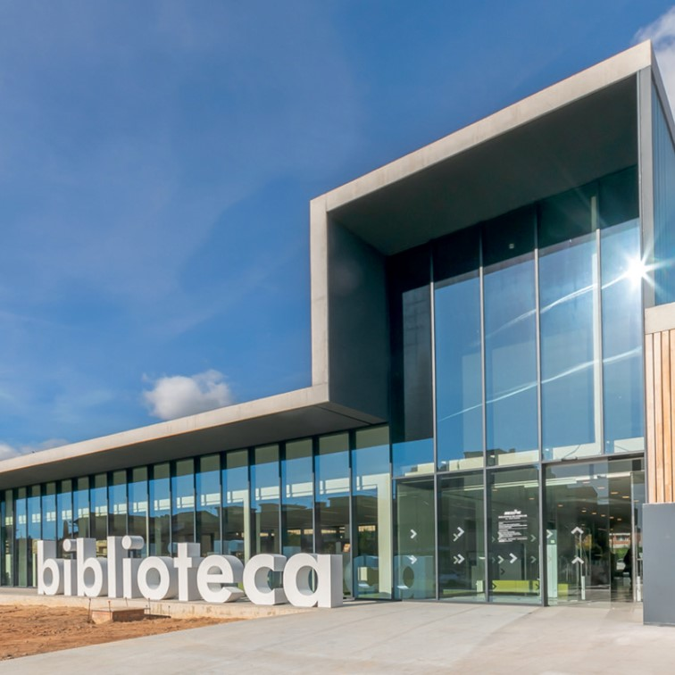
Innovation and knowledge axis
Featured Actions
Expand the XBM Model to all libraries on the Network
Notes:
Explanation: The XBM Model is a tool that marks the path to the library of the future. A library that preserves the essence and innovates in the methodologies of services promoting reading, access to information and knowledge, support for training and meeting space. The model is proposed as a common basis for all XBM libraries but, to have an impact, each library must adapt and differentiate it according to its environment. In the XBM Model, the relationship between the needs and interests of citizens and access to the guarantee of social equity and knowledge is represented in four areas of strategic action, according to the activity that is developed there. These areas are: Discover, Learn, Create and Share, each of which is related to a conceptual space: • A library where to discover: space for inspiration. • A library where to learn: space for learning. • A library where to create: space for creation. • A library to share: meeting space.

Slide 11
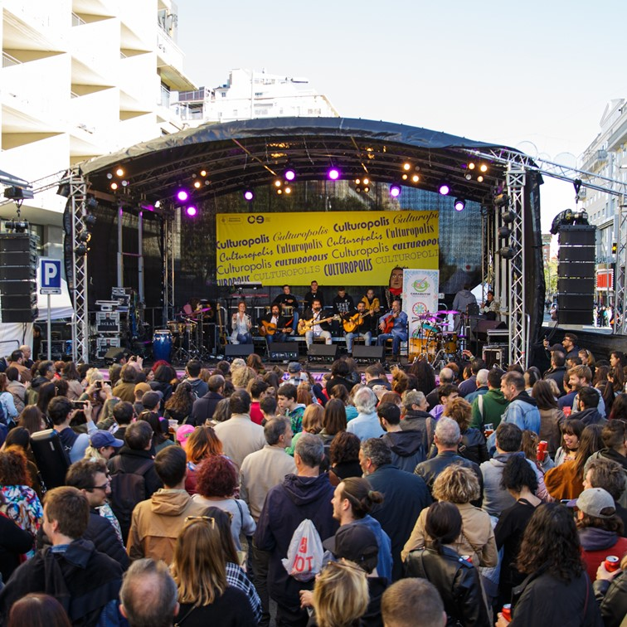
Innovation and knowledge axis
Featured Actions
2nd edition of Culturòpolis
Notes:
The 2007 Fribourg Declaration document grouped together various cultural rights to ensure their visibility and coherence and promote their full implementation. This year, the Culture Department, which has made a clear commitment to the DDCC since the approval of the Cultural Rights plan, will work on updating the Fribourg Declaration by drawing up the Barcelona Declaration. During the process, several working groups will be created and consultations will be held with citizens. The public presentation of the Declaration will be within the framework of Culturòpolis (Cultural Rights Conference) to be held between the end of September and the beginning of October in Barcelona, ​​coinciding with the Mondiacult (World Conference on Cultural Policies and Sustainable Development) in which the 194 member states of UNESCO will participate. We want to position Libraries and what is already happening in Libraries, and make them visible as active agents in favor of access to culture, universal and inclusive to reflect the diversity and richness of our communities.

Slide 12
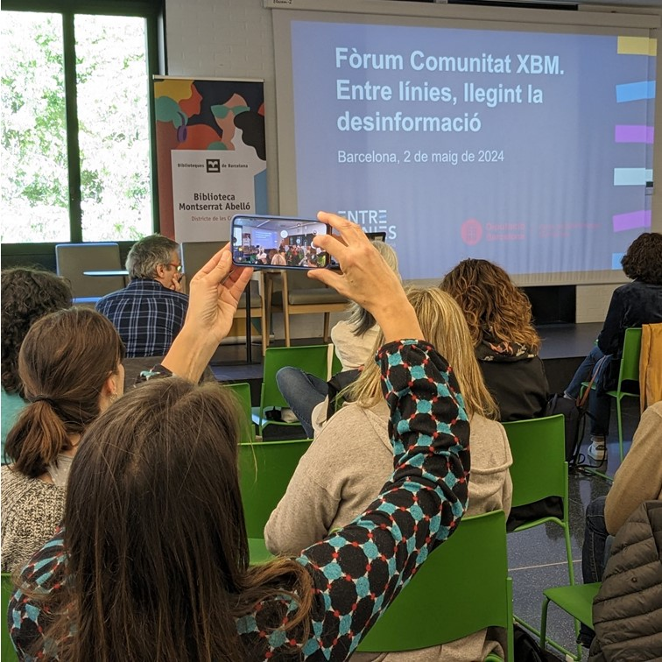
Innovation and knowledge axis
Features Actions
Between the lines, Reading the misinformation
Notes:
Explanation: In collaboration with Learn to Check we have generated various activities such as workshops and an “escape room” that test you and raise awareness and teach you to distinguish between true and false information. The project is developed based on a partnership between information professionals and librarians, with the necessary connection with other agents against disinformation, such as schools and other community spaces in the case of the adult public. We have held workshops with adolescents, the elderly and intergenerational groups, where young people learn to identify disinformation and then act as trainers for the elderly. Motivation: According to the latest Digital News Report, 64% of Spanish respondents are concerned about disinformation and digital literacy. Public libraries, as local agents that guarantee access to reliable information, offer information literacy and digital literacy workshops. However, the current situation makes it necessary to take measures and offer learning opportunities in media literacy as an important part of this line of action. From the Library Services Management (GSB) we want to accompany the libraries of the XBM in this commitment to fight against disinformation and promote a critical spirit, thus favoring more democratic and committed societies.

Slide 13
More information:
https://www.diba.cat/ca/web/biblioteques/bibliolab/projectes
https://www.diba.cat/documents/d/biblioteques/projectes-inspiradors_2024-pdf

Slide 14
Àrea de Cultura. Diputació de Barcelona
www.diba.cat/drets-culturals
Document available in:
https://www.diba.cat/documents/d/drets-culturals/cultura311-_pla_drets_culturals_diba_eng_web-1-.

